Slide 1
Schoolwide Positive Behavior Supports: A Prevention Framework for School Discipline
Tim Lewis, Ph.D.
University of Missouri
OSEP Center on Positive
Behavioral Intervention & Supports
pbis.org

Slide 2
Where is Missouri???

Slide 3
Starting Point….
We cannot “make” students learn or behave
We can create environments to increase the likelihood students learn and behave
Environments that increase the likelihood are guided by a core curriculum and implemented with consistency and fidelity

Slide 4
School-wide Positive Behavior Support
Problem solving framework
Systematic implementation of evidence-based practices
Layers in increasingly more intensive environmental supports to increase the likelihood students are academically, emotionally, and socially successful

Slide 5
Social Competence &
Academic Achievement
SW-Positive
Behavior
Support
OUTCOMES
Supporting
Decision
Making
Supporting
Staff Behavior
SYSTEMS
DATA
PRACTICES
Supporting
Student Behavior

Slide 6
Designing School-Wide Systems for Student Success
Academic Systems
Behavioral Systems
Intensive, Individual Interventions
Individual Students
Assessment-based
High Intensity
Intensive, Individual Interventions
Individual Students
Assessment-based
Intense, durable procedures
1-5%
1-5%
Targeted Group Interventions
Some students (at-risk)
High efficiency
Rapid response
5-10%
5-10%
Targeted Group Interventions
Some students (at-risk)
High efficiency
Rapid response
Universal Interventions
All students
Preventive, proactive
80-90%
80-90%
Universal Interventions
All settings, all students
Preventive, proactive

Slide 7
Universal
Targeted
Intensive
Continuum of Supports
Math
Science
Spanish
Soc skills
Reading
Horses
Notes:
NOTICE GREEN GOES IS FOR “ALL”

Slide 8
Essential Features at the School Level
Teams of educators within the school (administrator)
Data-based decision making
Instructional Focus
  Teach & Practice
Acknowledge student mastery of social skills
  Positive Feedback
Access to on-going Technical Assistance

Slide 9
Universal School-Wide Features
Clearly define expected behaviors (Rules)
  All Settings
  Classrooms
Procedures for teaching & practicing expected behaviors
Procedures for acknowledging expected behaviors
Instructional procedures for responding to problem behaviors
Procedures for data-based decision making
Family Awareness and Involvement

Slide 10
Benton Primary School
I am…. | All Settings | Classroom | Hallways | Cafeteria | Bathrooms | Playground | Assemblies
Safe | Keep bodies calm in line Report any problems Ask permission to leave any setting | Maintain personal space | Walk Stay to the right on stairs Banisters are for hands | Walk Push in chairs Place trash in trash can | Wash hands with soap and water Keep water in the sink One person per stall | Use equipment for intended purpose Wood chips are for the ground Participate in school approved games only Stay in approved areas Keep body to self | Walk Enter and exit gym in an orderly manner
Respect- ful | Treat others the way you want to be treated Be an active listener Follow adult direction(s) Use polite language Help keep the school orderly | Be honest Take care of yourself | Walk quietly so others can continue learning | Eat only your food Use a peaceful voice | Allow for privacy of others Clean up after self | Line up at first signal Invite others who want to join in Enter and exit building peacefully Share materials Use polite language | Be an active listener Applaud appropriately to show appreciation
A Learner | Be an active participant Give full effort Be a team player Do your job | Be a risk taker Be prepared Make good choices | Return to class promptly | Use proper manners Leave when adult excuses | Follow bathroom procedures Return to class promptly | Be a problem solver Learn new games and activities | Raise your hand to share Keep comments and questions on topic

Slide 11
Adams City High School
RAH | Classroom | Hallway/ Commons | Cafeteria | Bathrooms
Respect | Be on time; attend regularly; follow class rules | Keep location neat, keep to the right, use appropriate lang., monitor noise level, allow others to pass | Put trash in cans, push in your chair, be courteous to all staff and students | Keep area clean, put trash in cans, be mindful of others’ personal space, flush toilet
Achievement | Do your best on all assignments and assessments, take notes, ask questions | Keep track of your belongings, monitor time to get to class | Check space before you leave, keep track of personal belongings | Be a good example to other students, leave the room better than you found it
Honor | Do your own work; tell the truth | Be considerate of yours and others’ personal space | Keep your own place in line, maintain personal boundaries | Report any graffiti or vandalism

Slide 12
Tier II

Slide 13
Tier II (small group)
Efficient and effective way to identify at-risk students
  Screen
  Data decision rules
  Teacher referral
Informal assessment process to match intervention to student need
  Small group Social Skill Instruction
  Self-management
  Academic Support
Part of a continuum – must link to universal school-wide PBS system

Slide 14
Tier III (individualized support)
When small group not sufficient
When problem intense and chronic
Driven by Functional Behavioral Assessment
Connections to Mental Health and Community Agencies (Integrated Framework Monograph)
Part of a continuum – must link to universal school-wide PBS system

Slide 15
Connections to Mental Health and Community Agencies
www.pbis.org/school/school-mental-health/interconnected-systems

Slide 16
SW-PBS Outcomes

Slide 19
Parramatta High School
Notes:
Parramatta High School
Term 3 Classroom referrals by year
2006- 327
2007 -256
2008 -210
2009 -189
2010- 149
2011 -112
2012- 105
2013 -65

Slide 20
Parramatta High School
Notes:
Parramatta High Scho0l
Long Suspensions (minimum of 1 day- maximum of 20 days)
Short suspensions (minimum of 1 day maximum of 4 days)
Year Long Short Total Suspensions
2005 53 114 167
2006 22 130 152
2007 36 77 113
2008 31 58 89
2009 18 64 82
2010 7 29 36
2011 11 33 44
2012 10 20 30
2013 11 22 33

Slide 21
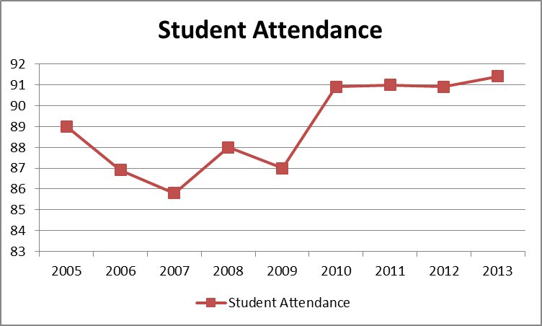
Parramatta High School
Notes:
Parramatta High School
Student attendance
2005 89
2006 86.9
2007 85.8
2008 88
2009 87
2010 90.9
2011 91
2012 90.9
2013 91.4

Slide 22
A&D = Alcohol and Drug; ABS = Anti-social Behavior Scale

Slide 23
Group Cost Benefit
Office Referral Reduction Across
12 PBIS schools= 5,606
If one Office Referral=15 minutes of administrator time, then 5,606 x 15=
84,090 minutes
1401.15 hours or
233 days
of administrator time recovered and reinvested.

Slide 24
Group Cost Benefit
Office Referral Reduction
Across 12 PBIS Schools =5,606
If students miss 45 minutes of instruction for each Office Referral, 5,606 X 45=
252,270 minutes
4204.50 hours or
700 days
of instructional time recovered!!!!!

Slide 25
RCT & Group Design PBIS Studies
Bradshaw, C.P., Koth, C. W., Thornton, L. A., & Leaf, P. J. (2009). Altering school climate through school-wide Positive Behavioral Interventions and Supports: Findings from a group-randomized effectiveness trial. Prevention Science, 10(2), 100-115
Bradshaw, C. P., Koth, C. W., Bevans, K. B., Ialongo, N., & Leaf, P. J. (2008). The impact of school-wide Positive Behavioral Interventions and Supports (PBIS) on the organizational health of elementary schools. School Psychology Quarterly, 23(4), 462-473.
Bradshaw, C. P., Mitchell, M. M., & Leaf, P. J. (2010). Examining the effects of School-Wide Positive Behavioral Interventions and Supports on student outcomes: Results from a randomized controlled effectiveness trial in elementary schools. Journal of Positive Behavior Interventions, 12, 133-148.
Bradshaw, C. P., Pas, E. T., Goldweber, A., Rosenberg, M. S., & Leaf, P. J. (2012). Integrating school-wide positive behavioral interventions and supports with tier 2 coaching to student support teams: The PBISplus model. Advances in School Mental Health Promotion 5, 177-193.
Bradshaw, C. P., Reinke, W. M., Brown, L. D., Bevans, K. B., & Leaf, P. J. (2008). Implementation of school-wide Positive Behavioral Interventions and Supports (PBIS) in elementary schools: Observations from a randomized trial. Education & Treatment of Children, 31, 1-26.
Bradshaw, C. P., Waasdorp, T. E. & Leaf, P. J. (2012). Effects of School-Wide Positive Behavioral Interventions and Supports on child behavior problems. Pediatrics, 130(5), 1136-1145.
Goldweber, A., Waasdorp, T. E., & Bradshaw, C. P. (in press). Examining the link between forms of bullying behaviors and perceptions of safety and belonging among secondary school students. Journal of School Psychology.
Horner, R., Sugai, G., Smolkowski, K., Eber, L., Nakasato, J., Todd, A., & Esperanza, J., (2009). A randomized, wait-list controlled effectiveness trial assessing school-wide positive behavior support in elementary schools. Journal of Positive Behavior Interventions, 11, 133-145.
Horner, R. H., Sugai, G., & Anderson, C. M. (2010). Examining the evidence base for school-wide positive behavior support. Focus on Exceptionality, 42(8), 1-14.
Waasdorp, T. E., Bradshaw, C. P., & Leaf, P. J. (2012). The impact of School-wide Positive Behavioral Interventions and Supports (SWPBIS) on bullying and peer rejection: A randomized controlled effectiveness trial. Archives of Pediatrics and Adolescent Medicine, 116(2), 149-156
Reduced major disciplinary infractions & aggression
Improvement in concentration, prosocial behavior, & emotional regulation
Improvements in academic achievement
Enhanced perception of organizational health & safety
Reductions in teacher reported bullying behavior & peer rejection
Improved school climate

Slide 28
For More Information
OSEP Center for Positive Behavioral Interventions and Supports
pbis.org
Missouri School-wide Positive Behavior Support
pbismissouri.org

