Slide 1
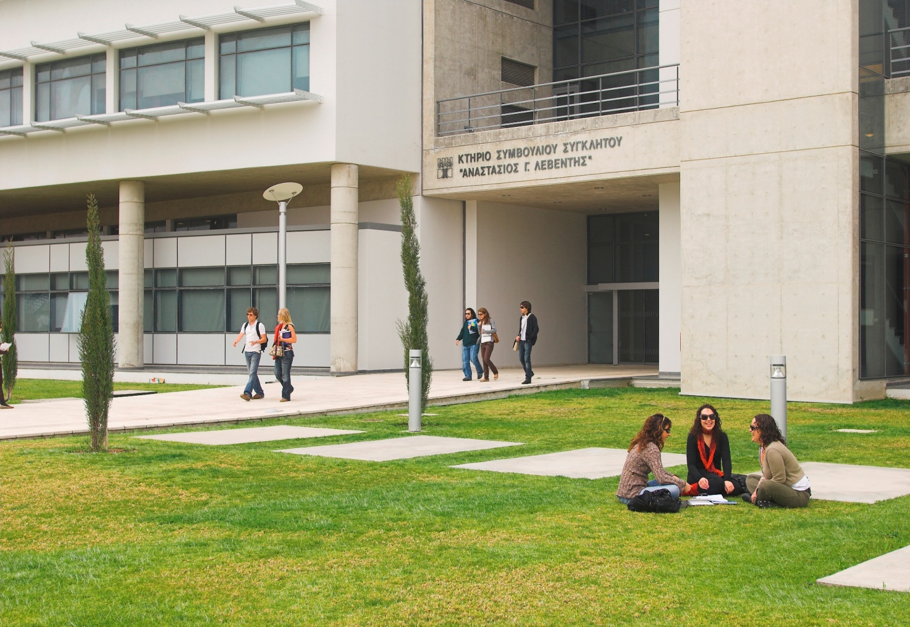
University of cyprus at a glance

Slide 2
General Information
Established: 1989
First Undergraduate students (486): September 1992 (3 Faculties, 10 Departments)
First Postgraduate students: 1997
The University Campus is expected to be completed by 2020, with 9 Schools, 25+ departments, ~10.000 students.
25 + πλέον τμήματα, ~10.000 φοιτητές
Landmarks
Network for Universities of the Capitals of Europe (UNICA): Presidency up to 2011
Carnegie Foundation Classification for Higher Education Institutions: Placed as a Doctoral/Research Universities – Intensive
Shanghai World University ranking: 2009 Ranked at 1.192 worldwide

Slide 3
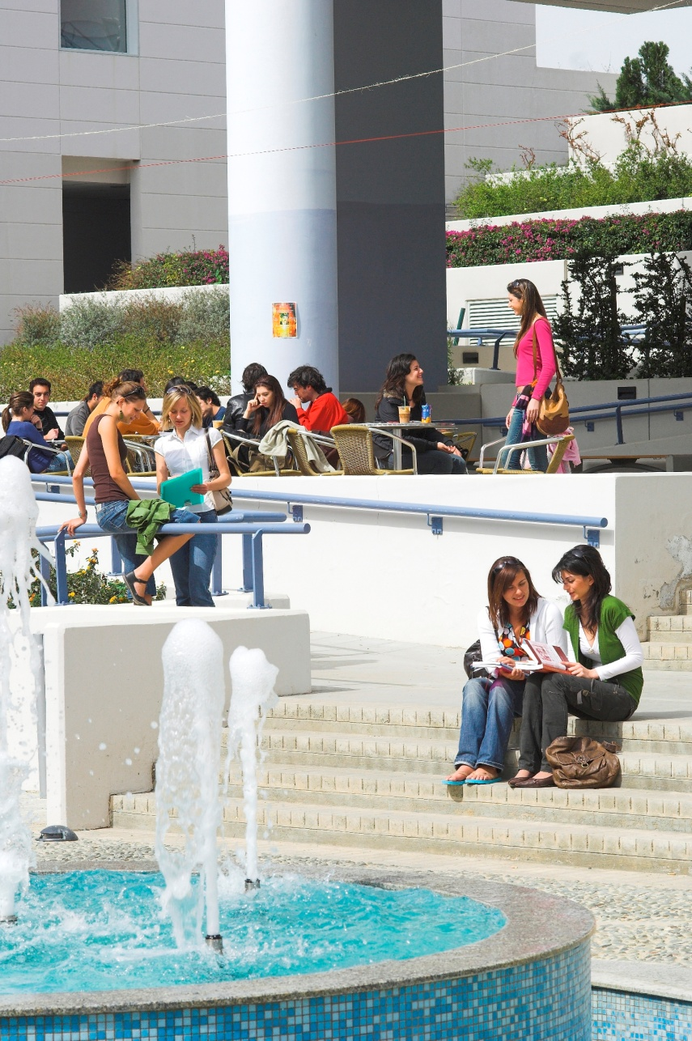
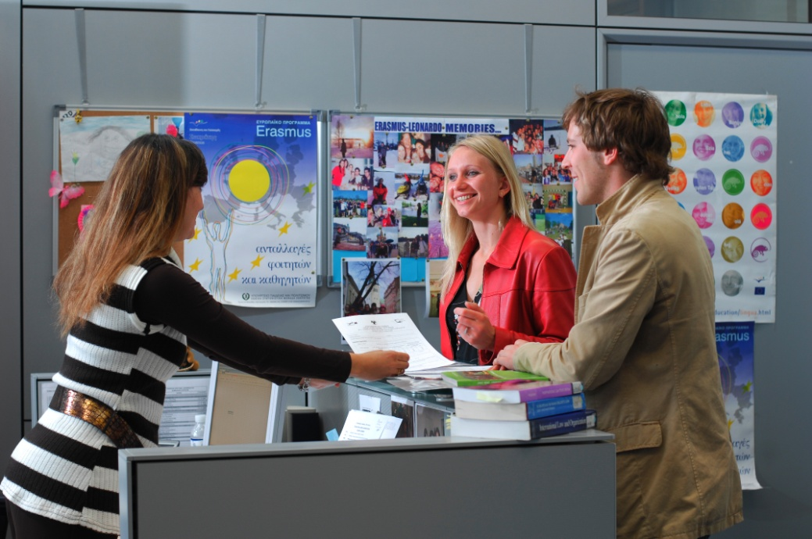
Figures
37 Undergraduate programs
60 Postgraduate programs (Masters)
6 Postgraduate programs in English
43 Phd programs
5.043 Undergraduate students
1.282 Postgraduate students
556 Doctoral students

Slide 4
8 Faculties
Faculty of Humanities
Faculty of Pure and Applied Sciences
Faculty of Social Sciences and Education
Faculty of Economics and Management
Faculty of Engineering
Faculty of Letters
Faculty of Graduate Studies
Medical School

Slide 5
22 Departments
Faculty of Humanities
English Studies
French Studies and Modern Languages
Turkish and Middle Eastern Studies
Language Centre
Centre for Gender Studies (also under the aegis of the Faculty of Social Sciences and Education)
Faculty of Pure and Applied Sciences
Biological Sciences
Mathematics and Statistics
Computer Science
Physics
Chemistry
Oceanography Centre
Faculty of Social Sciences and Education
Education
Social and Political Sciences
Law
Psychology
Centre for Gender Studies (also under the aegis of the Faculty of Humanities)
Faculty of Economics and Management
Public and Business Administration
Accounting and Finance
Economics
Economics Research Centre
Centre for Banking and Financial Research
Faculty of Engineering
Electrical and Computer Engineering
Mechanical and Manufacturing Engineering
Civil and Environmental Engineering
Architecture
Hephaistos Nanotechnology Research Centre
KIOS Research Centre for Intelligent Systems and Networks
Faculty of Letters
Byzantine and Modern Greek Studies
School of Modern Greek
History and Archaeology
Archaeological Research Unit
Classics and Philosophy
Cultural Centre

Slide 6
Research Laboratories (97)
Faculty of Humanities (1)
Faculty of Pure and Applied Sciences (55)
Faculty of Social Sciences and Education (16)
Faculty of Economics and Management (2)
Faculty of Engineering (26)
Faculty of Letters (3)

Slide 7
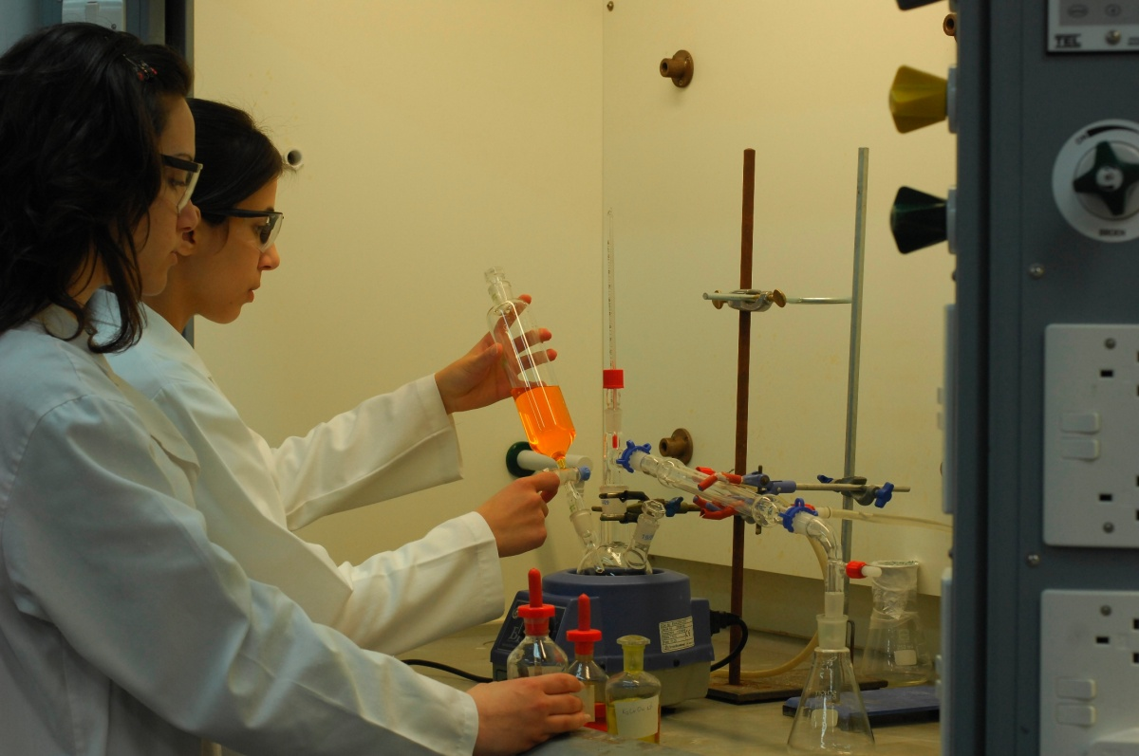
Research Units/Centres
Archaeological Research Unit
Research Centre of Gender Studies,
Centre for Banking and Financial Research
Economics Research Centre
Hephaistos Nanotechnology Research Centre
KIOS Research Centre for Intelligent Systems and Networks
Oceanography Centre
Nireas – International Water Research Center

Slide 8
Chairs/Centres
Faculty of Social Sciences and Education
Jean Monnet Chair in European Political Integration
Jean Monnet Chair in Foreign Policy
Jean Monnet Chair in European Economic Integration
UNESCO Chair in Gender Equality and Empowerment
Jean Monnet Centre of Excellence.
Faculty of Economics and Management
Bank of Cyprus Chair for Finance
Marfin-Laiki Chair in European Studies
Columbia Shipmanagement Chair in Strategic Management
Giorgos Vasiliou Chair in Marketing and Market Research.
Faculty of Engineering
Marie Curie Chair of Excellence, TUMOURANGIO
Faculty of Letters
Chair of Underwater Archaeology

Slide 9
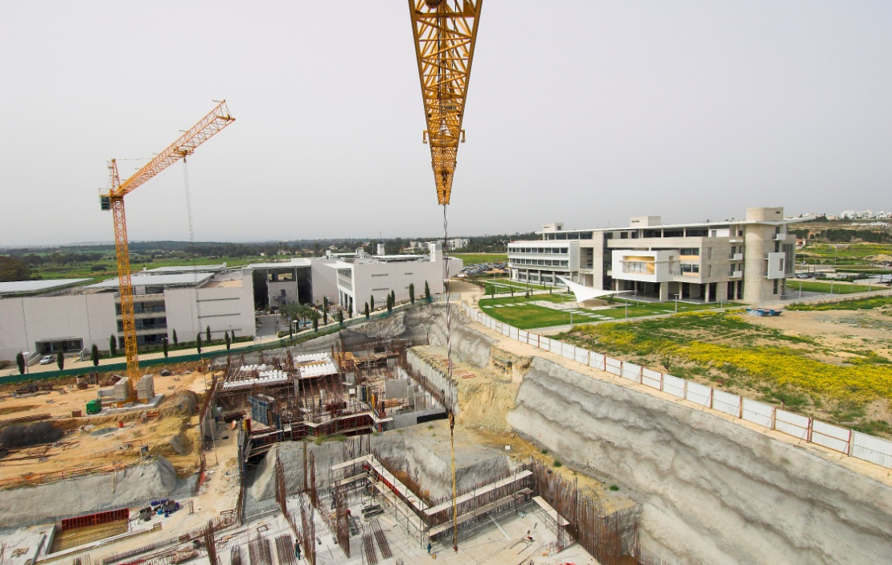
Next Goal- Establishment of 1 new Faculty
School of Fine Arts
9 Faculties
25 and more Departments
10.000 students
2020: Completion of the new University Campus

Slide 10
Number of students per academic year

Slide 11
Number of postgraduate students per academic year

Slide 12
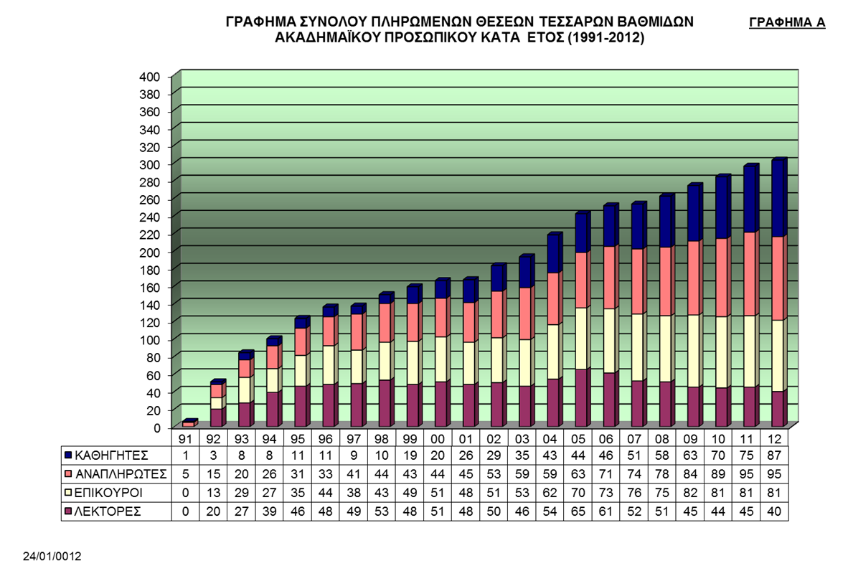
Faculties staff members (1991-2011)

Slide 13
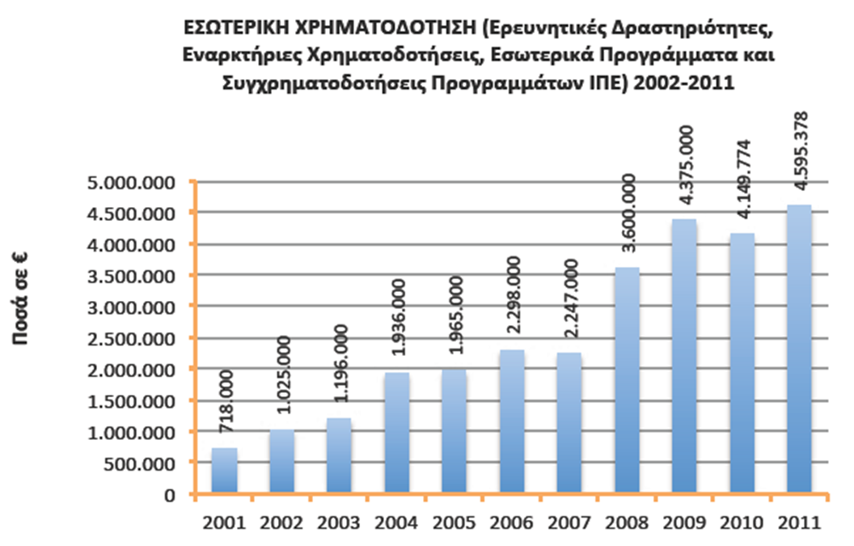
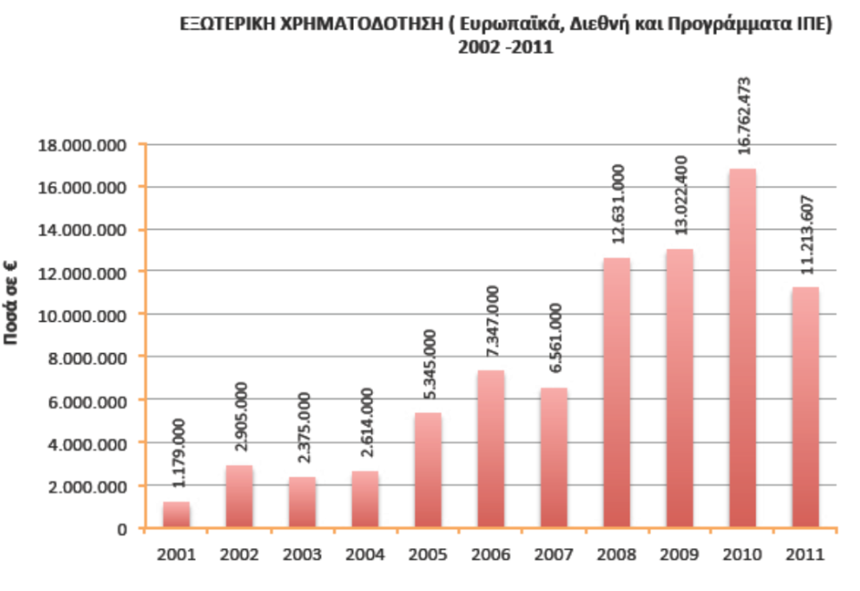
Research State Fund
Research funds from extrenal sources

Slide 14
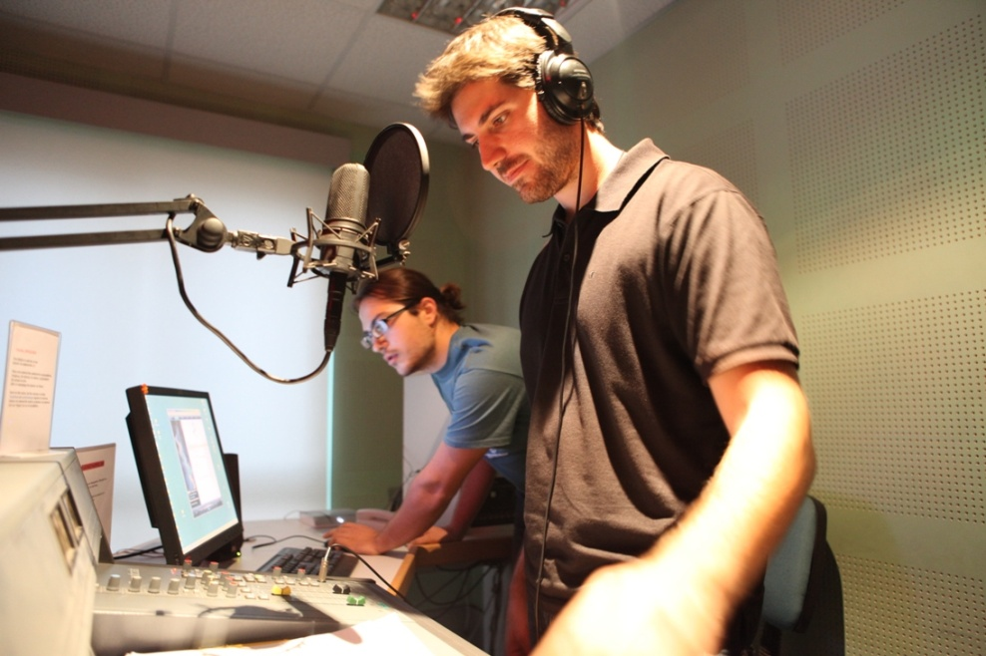
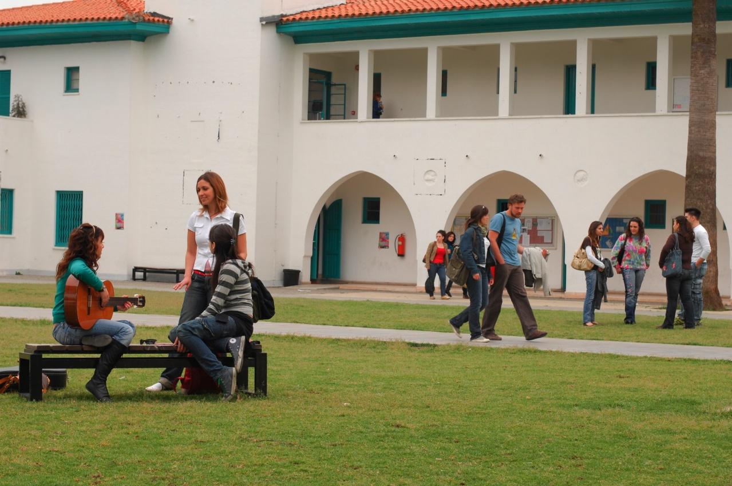
Student life
25 student Clubs
Student Halls
Social facilities centre
Sports centre
Copy centre
Radio Station UCY Voice

Slide 15
EFQM award “Recognized for Excellence” with 3 stars.
~270.000 books
~70.000 volumes of periodicals
Archaeological and Turcological collections of books (housed at other buildings)
Reading room with 200 seats
Digital Library
Audiovisual material collection (cds, dvds, microfilms, videocassettes, etc)
International cooperation and interlibrary loan service (ILL)
Library and Information Services for Blind and Visually impaired users (Braille).
UNIVERSITY LIBRARY
INFORMATION CENTRE
LIBRARY STELIOS IOANNOU
Designed by the world famous architect
Jean Nouvel

Slide 16
Student Halls
14 independent buildings
208 rooms
Common and other areas

Slide 17
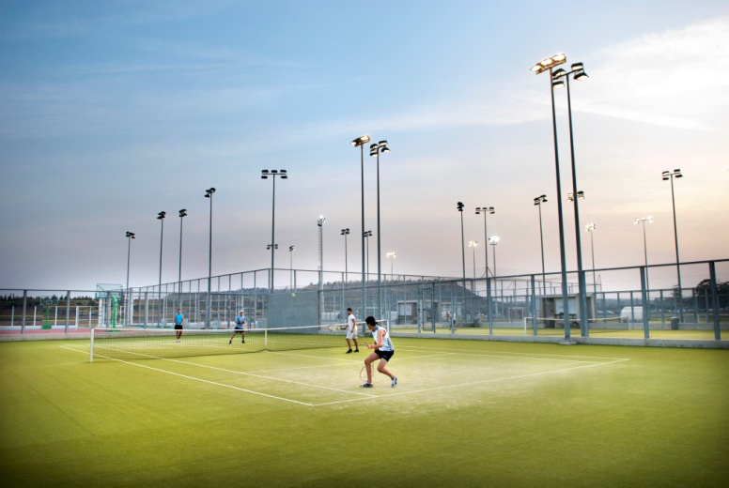
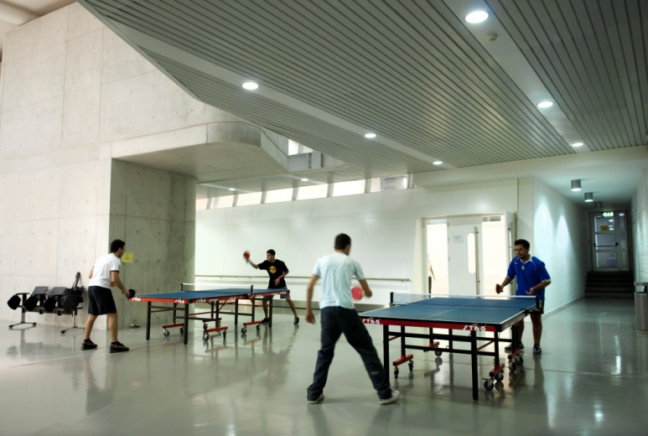
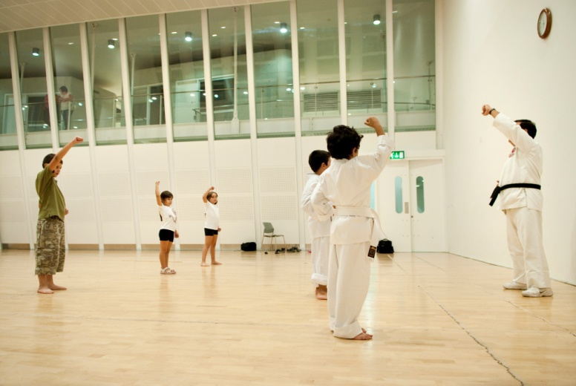
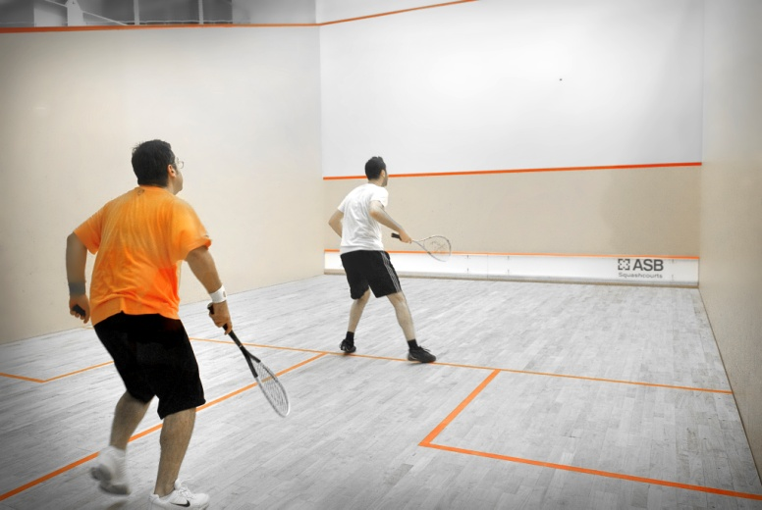
Sports centre
Indoor sports facilities with rooms for aerobics, martial arts, weight-training, Squash etc.
Courts for football, futsal, handball, volleyball, basketball, tennis and beach volley

Slide 18
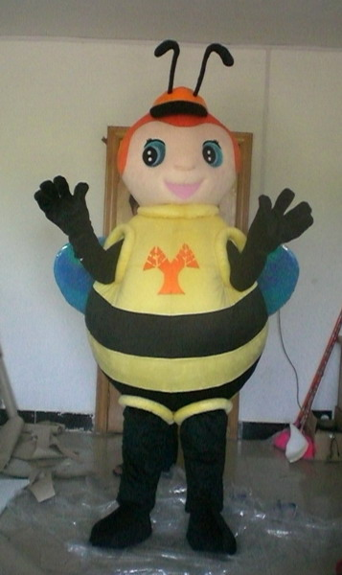
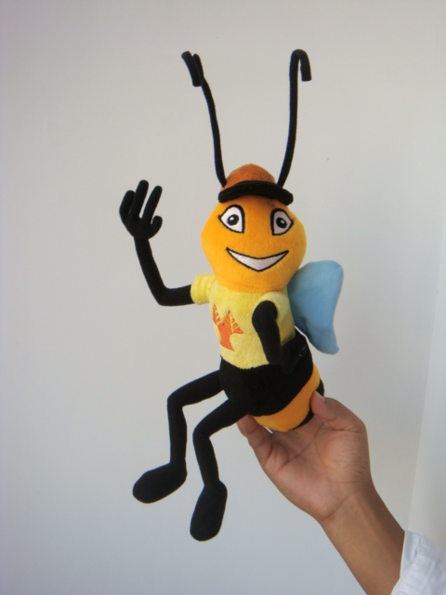
Alumni
Alumni Office
Council for Alumni
Alumni Association
UCY Mascot: Sophia the bee
Special privileges for Alumni
Events
Alumni magazine

